Slide 1
MOVIE TICKET BOOKING SYSTEM
BY :
YOGITHA-160117737030
ARUN RAJ-160117737034

Slide 2
Contents
Introduction
Motivation and problem statement
Existing systems and proposed system
Expected results
Conclusion and future scope
References

Slide 3
INTRODUCTION
This project is aimed at developing a ticket reservation system for cinema hall.
This project will automate the reservation of tickets and enquiries about availability of the tickets.
This project includes seating arrangement
for customer to book tickets.

Slide 4
MOTIVATION AND PROBLEM STATEMENTS
In rural areas, it is difficult to know the availability of required seats of cinema hall.

Slide 5
EXISTING SYSTEM:
Book my show
Ticket New
PVR Cinemas
Fun Cinemas

Slide 6
PROPOSED SYSTEM:
This project is built by using c++ language.
The header files used are
#include<iostream>
#include<fstream>.
Classes are used with data members and member function respective to source code.
In the main all the arrays are initialized to zero.
When required information such as type of ticket, row and column are given to the console.
‘0’ is overwritten with ‘1’.
We get a prompt that do you want to choose another ticket or not.
Files concept is used to store the seating arrangement of respective show timings.

Slide 7
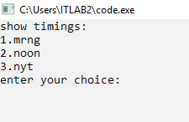
OUTPUT SCREEN:

Slide 8
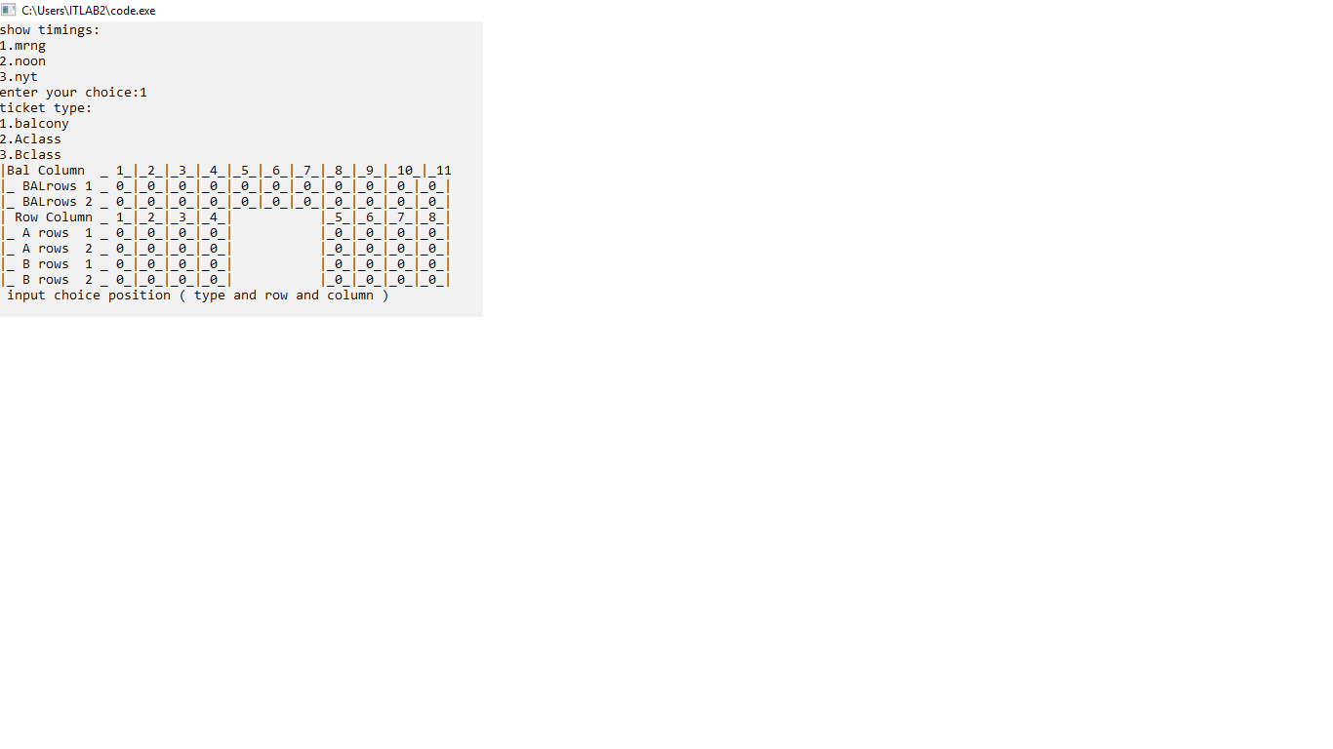

Slide 9
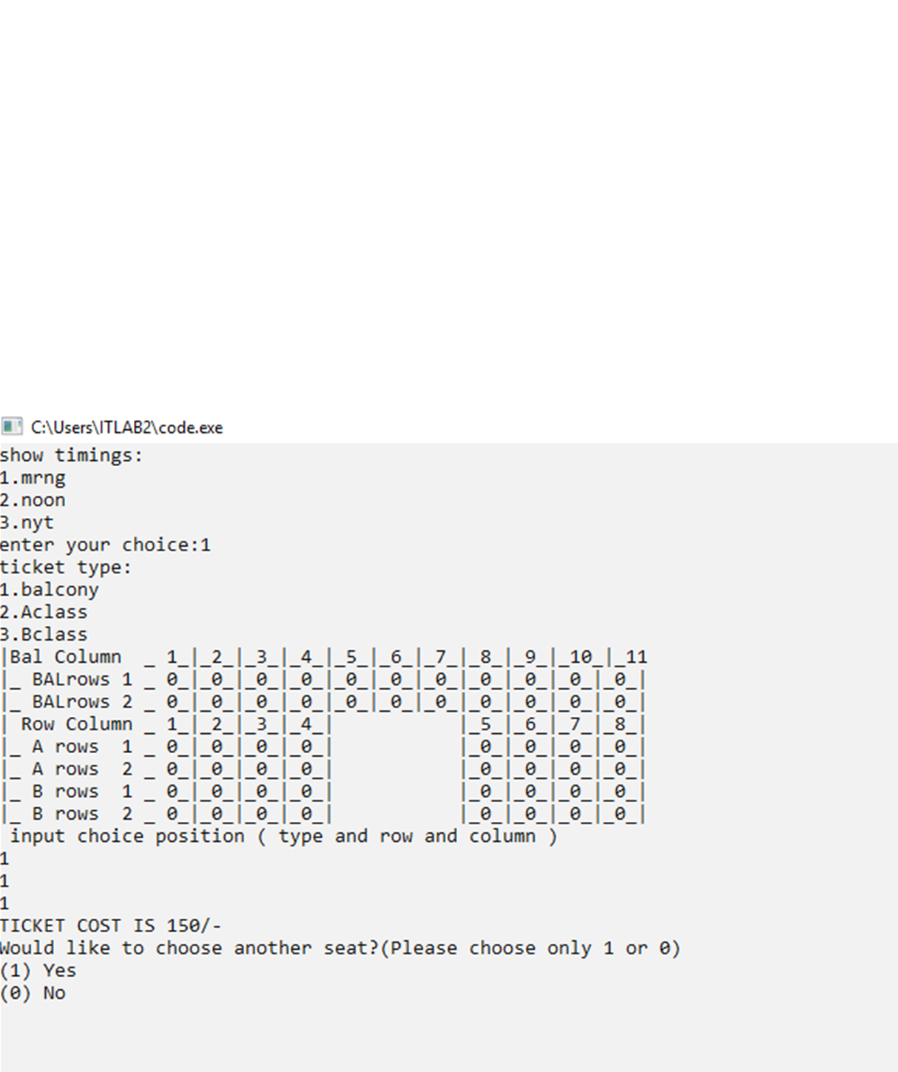

Slide 10
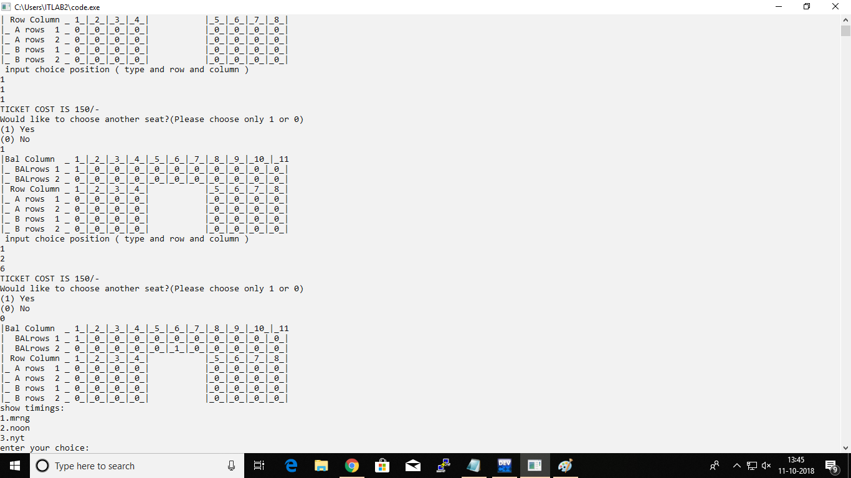

Slide 11
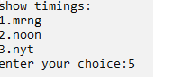

Slide 12
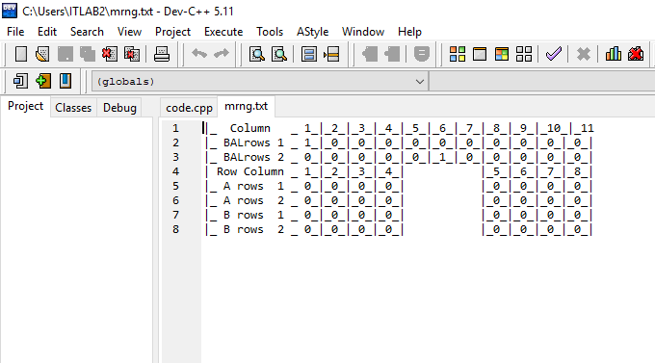

Slide 13
CONCLUSION :
Seating arrangement of specified show timings are stored in files.
FUTURE SCOPE:
By implementing graphics, web technology this project will be user friendly.

Slide 14
REFERENCES:
Mastering c++ (by K. R. Venugopal, Rajkumar buyya)

